Slide 1

Team Software Project: Uni Marketplace
Team:
Hrithik Chandra
Jemima Anil George
Anderson Sugianto
Sujan Gurung
Mahfuza Begum

Slide 2
Uni Marketplace: For Students, By Students !!
Aims :
To design and prototype an online marketplace platform providing the means to sell or buy good quality second-hand products to Students, by Students.
Allow access to a database of second-hand products, Seller contact information, location.
Provide access to a map system that allows users to determine their pick-up/drop-off location at the university.
Wishlist and Cart feature.
Device agnostic access – Access on the move.
Face-2-Face financial exchange
Notes:
Primary Features –
Only Uni students can access; requires authentication – Sign up/ Log in using Uni email, 2-FA
Filter products based on product type, price;
Sorting products based on Price, Trending Product Type
Shopping Cart (Individual, total price, mode of payment)
Primarily selling Second hand products, and free ones.
Secondary Features –
Multiple university and university log ins
Map location of drop off/pick up points
Payment on delivery, Cash or Card/Contactless, Direct Transfer.
Multiple drop off/pick up points around/in Uni for delivery or picking up delivery.
Returning Product and Payment in-case of defective product; Wishlist;

Slide 3





What we are trying to Solve
Cost optimisation
Easy access to cost effective products
Reduce the overhead of additional charges (delivery, markup).
Ability for students to have easy access to good quality used products and being financially viable.
Reliability
Physical access to the goods you purchase prior to orders. Bringing the buyer and the seller together in the actual exchange rather than relying on digital and 3rd party mechanism.
Student Convenience
Able to lead a comfortable university life with cost effective necessities and not compromise on living standard and quality.
Students able to generate revenue when completing their studies and helping other students lead a comfortable university life.
Sustainability
Reusing products and materials for as long as possible reduces the need for virgin materials and reduces the environmental footprint of materials use, hence contributing to sustainable development.
Notes:
The Problem Statement :
We are trying to solve the lack of easy access to Sell or Purchase good-quality used products. This is because every student may not be having sufficient financial ability to afford first-hand products.
Thus, making lives of university students easier by providing them means to buy affordable products or be able to sell what they don’t need anymore
--------------------------------------------------------------------------------------------------------------------------------------------------------------------------------------------------------
Why the project is created –
Even though there are popular online platforms dealing in second hand products available (like Amazon, eBay, Facebook marketplace, Vinted, etc.), they are not focussed on a University Student’s specific needs; hence the search becomes complex.
Also, the Sellers of the platform may not be Students, or they may be living far away,
Hence, the buyer may end up paying an additional delivery charge.
And they physical verification of the quality and usability of the product becomes impossible.
---------------------------------------------------------------------------------------------------------------------------------------------------------------------------------------------------------
Who benefits most –
The main beneficiary of this project are students
---------------------------------------------------------------------------------------------------------------------------------------------------------------------------------------------------------

Slide 4







User Journeys – Student as a Seller / Buyer
Seller Registration
Registers as a Seller
Agrees to Terms and conditions
Manage Product Inventory
Upload product description
Availability and price
Process Order
Order details
Buyer details
Manage own products
Payment mode
Delivery details
Deliver Order
Make product available at pickup point
Receive payment
Handover product
Seller
Buyer Registration
Registers as a Buyer
Agrees to Terms and conditions
Search Inventory
Search required product
Create Order
Add to cart
Provides/selects delivery details
Receive Order
Receive product from agreed pickup point
Make payment
Select product for purchase
Place order
Buyer
Devices:
Notes:
Seller’s Perspective :
Seller uploads the pictures/videos of the item, a proper description, specifying category, brand, Condition, How old it is, price, selling start and end dates and seller’s contact information.
Seller agrees to only two forms of payment – Cash or Bank Transfer
In the Selling Page, there is an inventory of all the items that the Seller has already sold, and those pending sale.
The transaction process specifies when the sale is going to happen, pick-up/drop-off point and mode of payment (cash or direct online transfer)
There is also a Summary page, where all items sold are listed (or all past transactions details) and the total profit.
Buyer’s Perspective :
Buyer selects the item that they want to purchase --
If they wish to buy it immediately, they LOCK THE DEAL , the Seller, gets a notification that the item has been “locked”.
If a customer, wants to buy that item, the seller receives a message from the customer, and they discuss about the process of transaction
The buyer contacts the seller to discuss about the date, time, location of the purchase.
Mode of payment decided by the buyer
If they want further information or evidence of the product, they can message the seller and they must provide it.

Slide 5
Roles
Hrithik Chandra | Jemima Anil George | Anderson Sugianto | Mahfuza Begum | Sujan Gurung
Current Team Leader and Website Design | Research Lead | Mobile version Design | Visual Artist – Colour schemes, Fonts, Logo | Website Design
Research into – Research on platform and technology choice | Research into – Related Security and Privacy research and associated laws | Research into Similar sites – Benchmark sites; Key Features | Research into Design – Standard design principles; human centric; Accessibility and Usability | Research into Responsive Web Design,
Website Design Mock up | Website Design Mock up | Mobile Design Mock up | Logo Designs Mock up | Website Design Mock up
Project Management, Team GitHub, Trello Management, | Gantt Chart Production and Management
Coding/Building | Coding/Building | Coding/Building | Coding/Building | Coding/Building

Slide 6
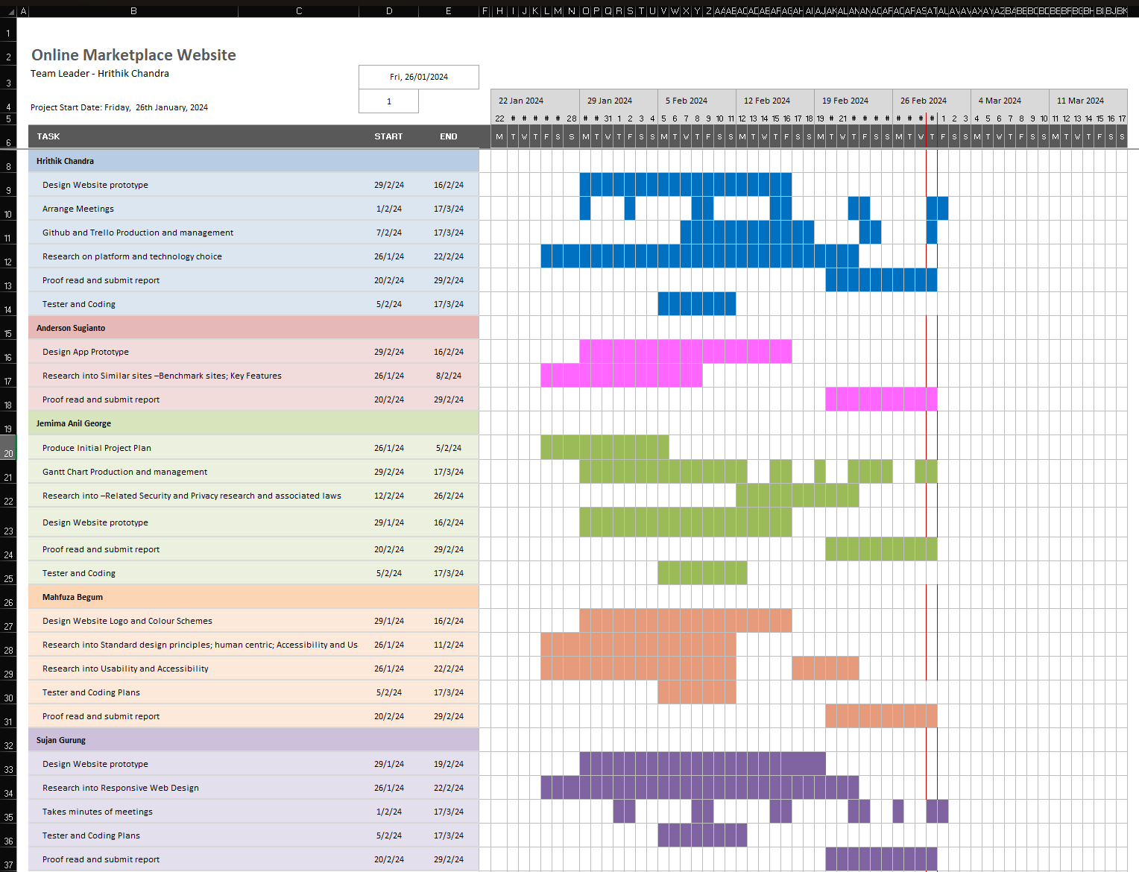
Gantt Chart
Notes:
This is our Gantt Chart.
It is a visual tool used for project management.
It helps us to know the task allocation, target dates and days the team members have worked.

Slide 7
Hrithik’s Work To Date
My main responsibilities in the group are to serve as Team Leader, Project Manager, Prototyping, Product Creator.
I have conducted the following work to date:
Research into a suitable platform for the Application (website, web app, hybrid app, native app).
Research into the different ways, as well as technologies and techniques for creating a Responsive Web App. (no-code, low-code, traditional ground up coding)
Designing and Prototyping a high-fidelity responsive mock-up of the website version.
Team GitHub, Trello management and Presentation.

Slide 8
Hrithik’s Work To Date
Source Research Slides
Why are we using the Web App Platform ?
Web App
Ease of Access
Ease of Deployment
Quick Turnaround
Cross-platform
Scalable
Ease of Integration
User friendly web app!!
Browser based
Platform agnostic
Managed Hosting
Website builder/
Low/No code platforms
Browser based
Notes:
Why we are using the Web App platform and What technologies we will be using for now ----
A web app would likely be the best solution for our Marketplace. Here's why:
Ease of Access:
University students are likely to access the marketplace using a variety of devices such as laptops, smartphones, and tablets. A web app would ensure accessibility across all these devices without the need for platform-specific development.
Ease of Deployment:
With a web app, deployment is straightforward as users can access the marketplace through their web browsers without the need for installation. This makes it easier to roll out updates and improvements to the platform.
Development Cost and Time/ Quick Turnaround:
As a computer science project, resources such as time and budget may be limited. Developing a web app typically requires fewer resources compared to native or hybrid apps, allowing you to focus more on the core functionalities of the marketplace.
Cross-Platform Compatibility:
Since university students may use different devices and operating systems, having a cross-platform compatible solution is essential. A web app ensures that the marketplace can be accessed regardless of the device or platform being used.
Scalability:
As the project may expand over time and potentially involve a larger user base beyond the university, a web app offers scalability. It can easily accommodate increasing traffic and users without significant adjustments to the underlying infrastructure.
Ease of Integration:
University students may already be familiar with using web-based platforms for various purposes. Integrating the online marketplace into their existing workflows and routines would be seamless with a web app.
Considering these factors, a web app provides a practical and effective solution for creating our online marketplace tailored to university students' needs.

Slide 9
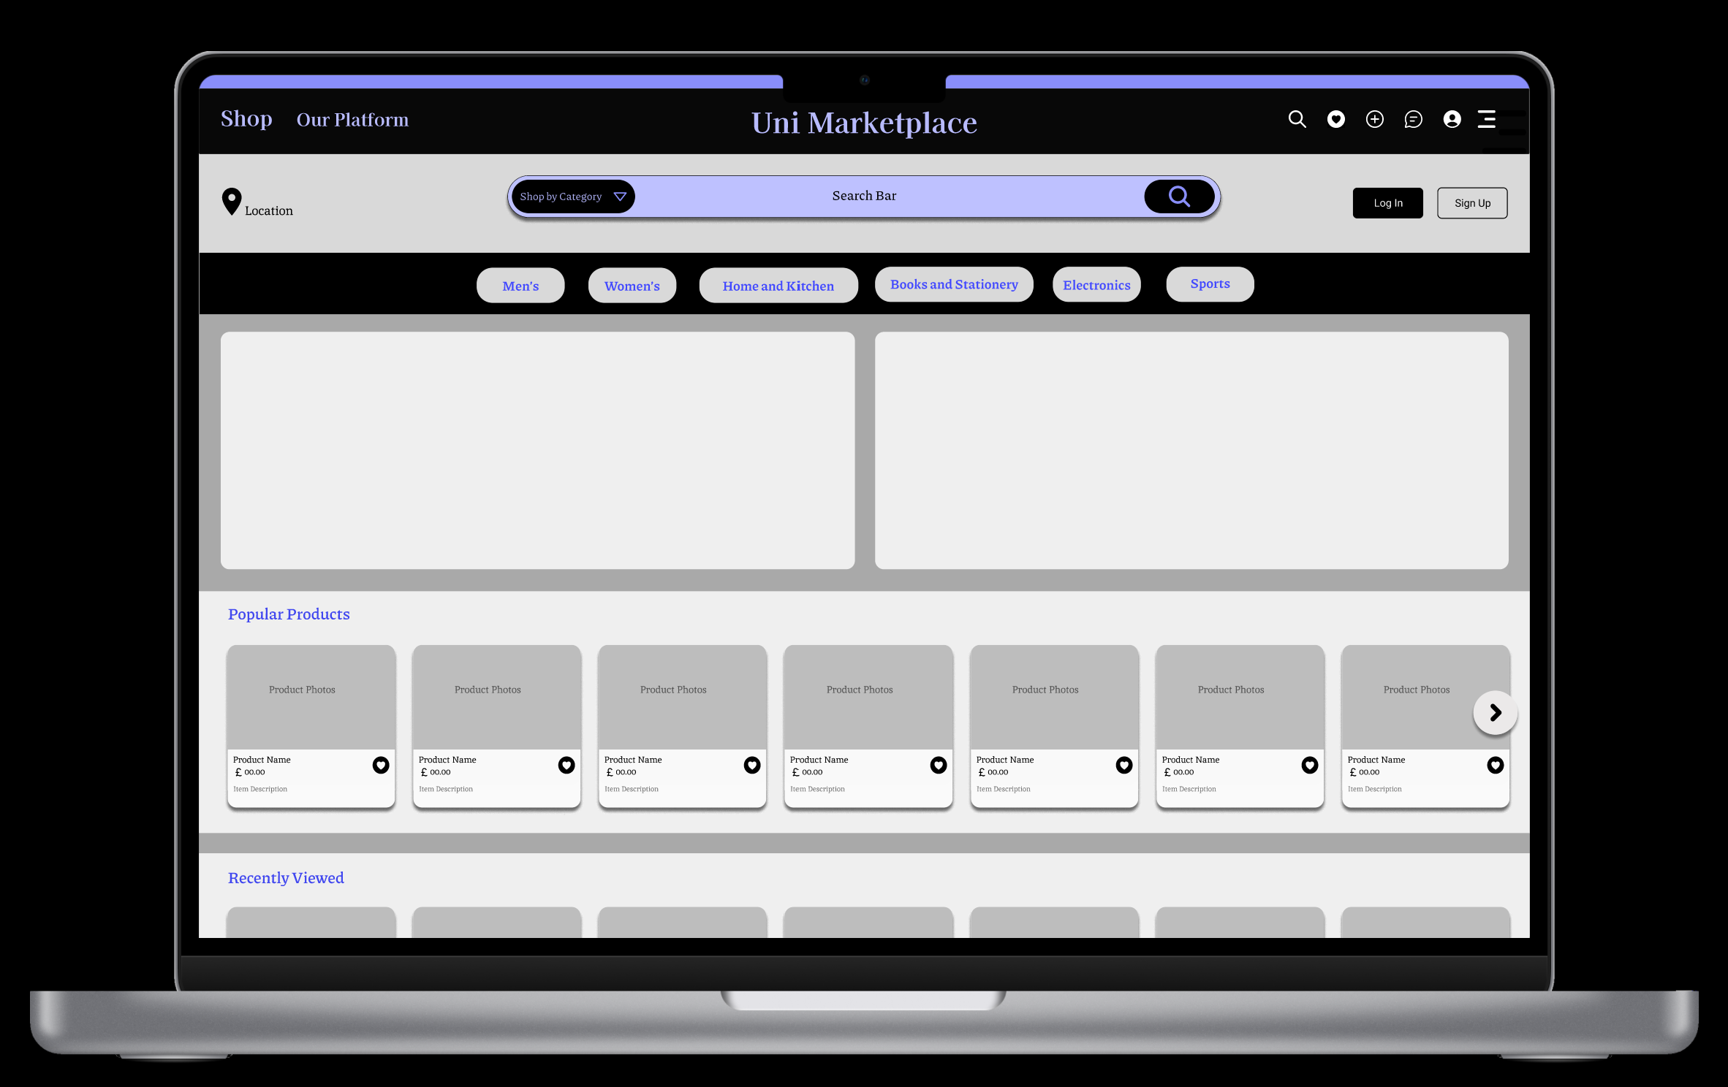
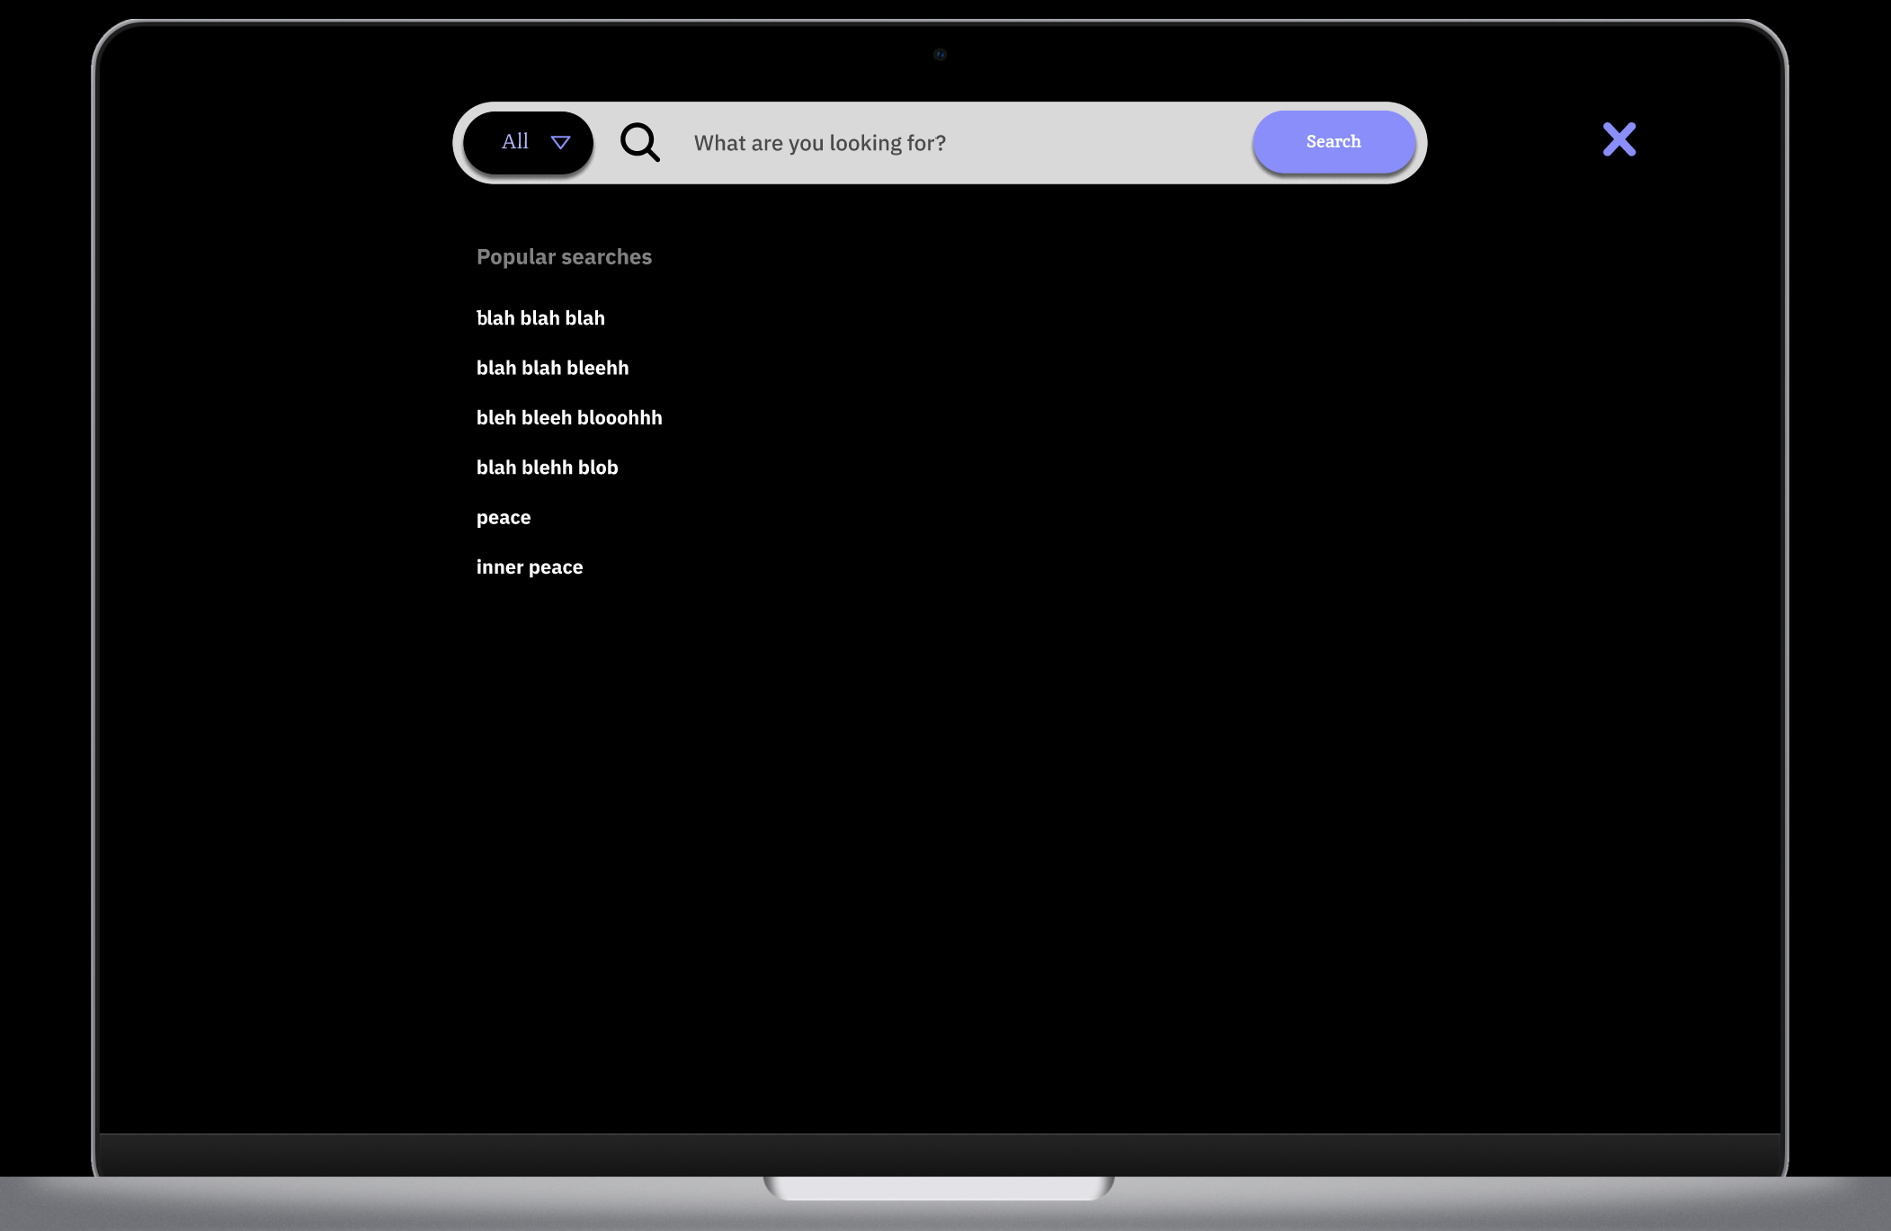
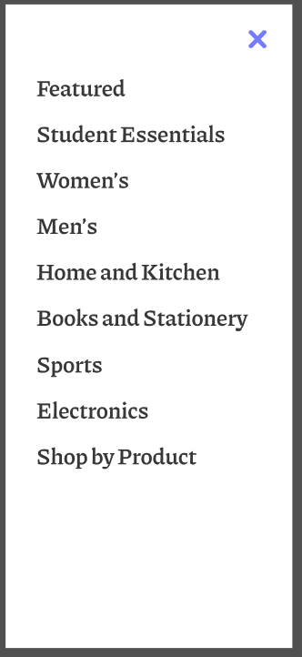
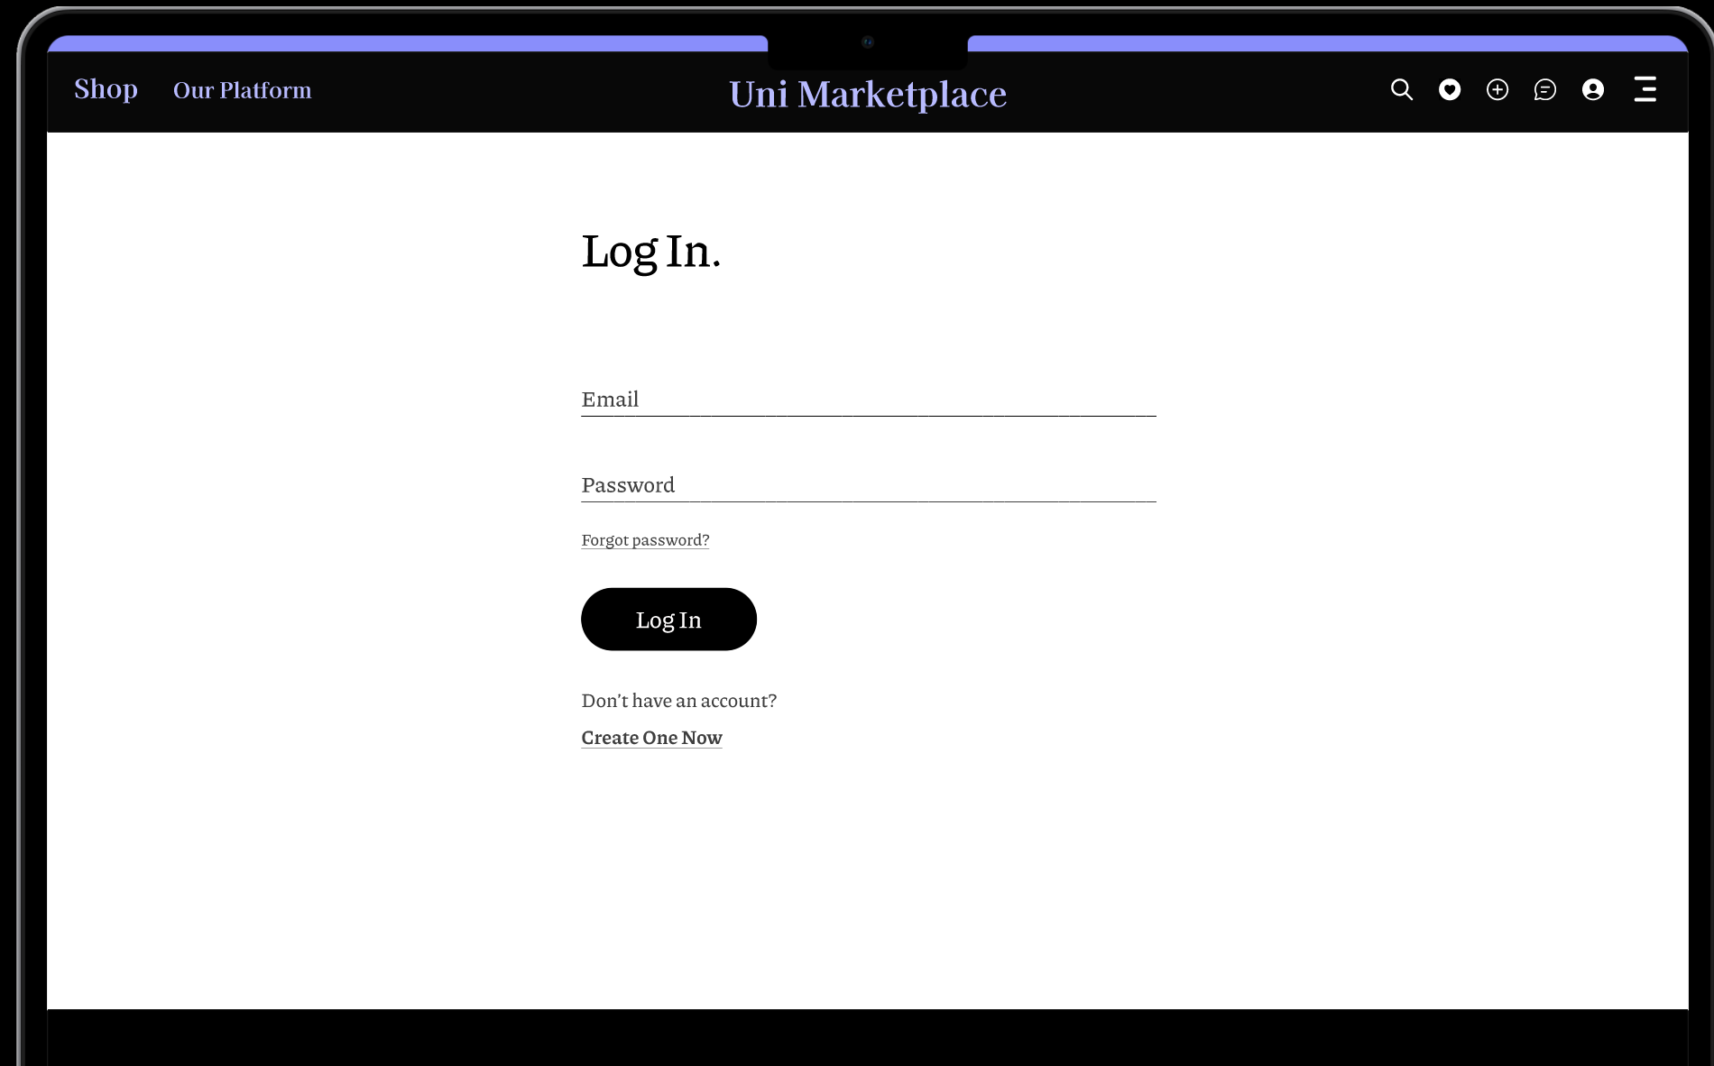
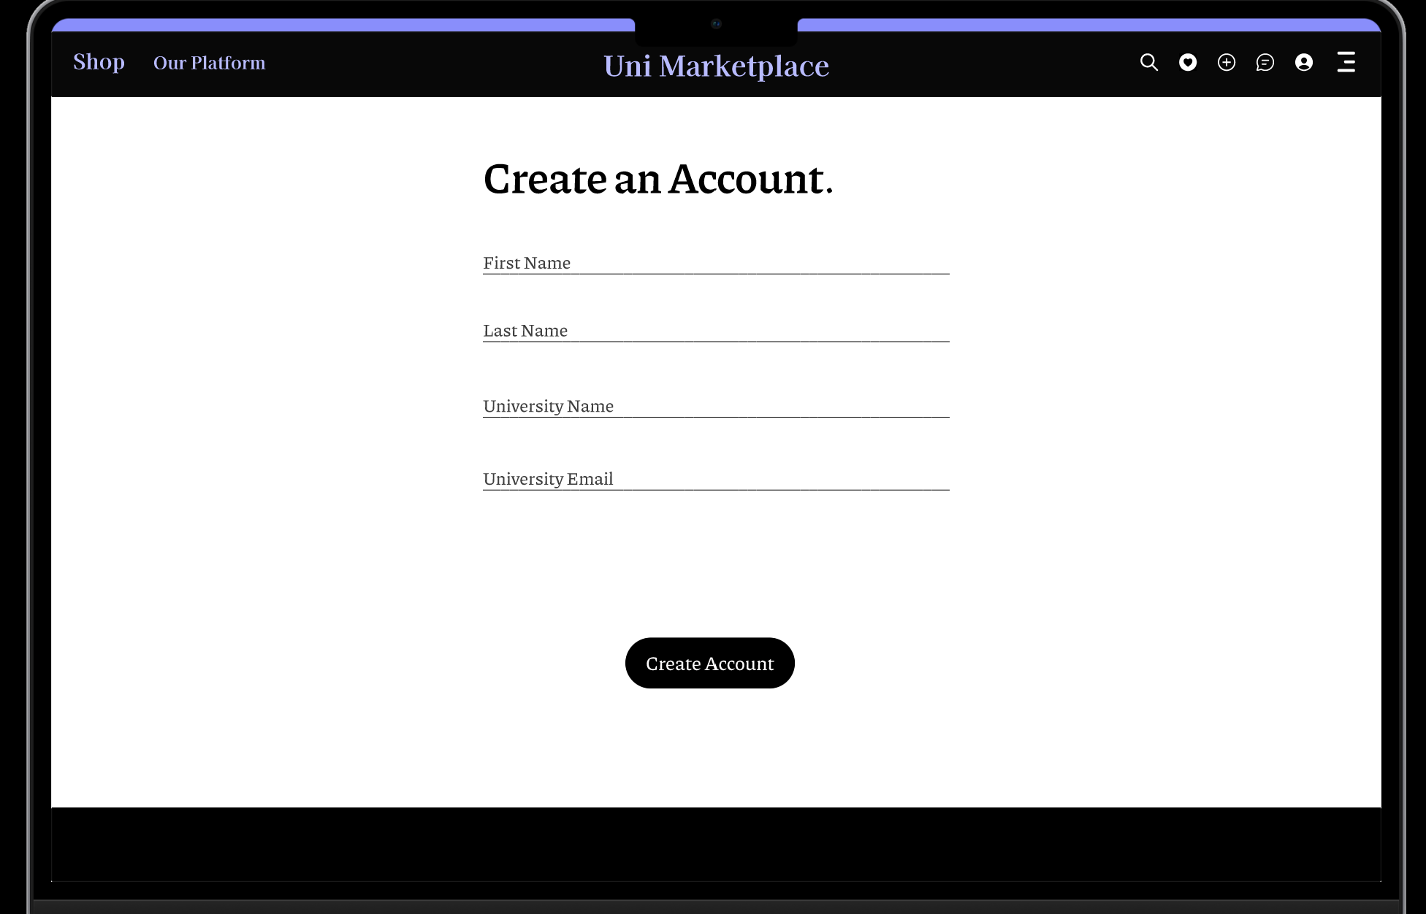
Hrithik’s Design Work

Slide 10
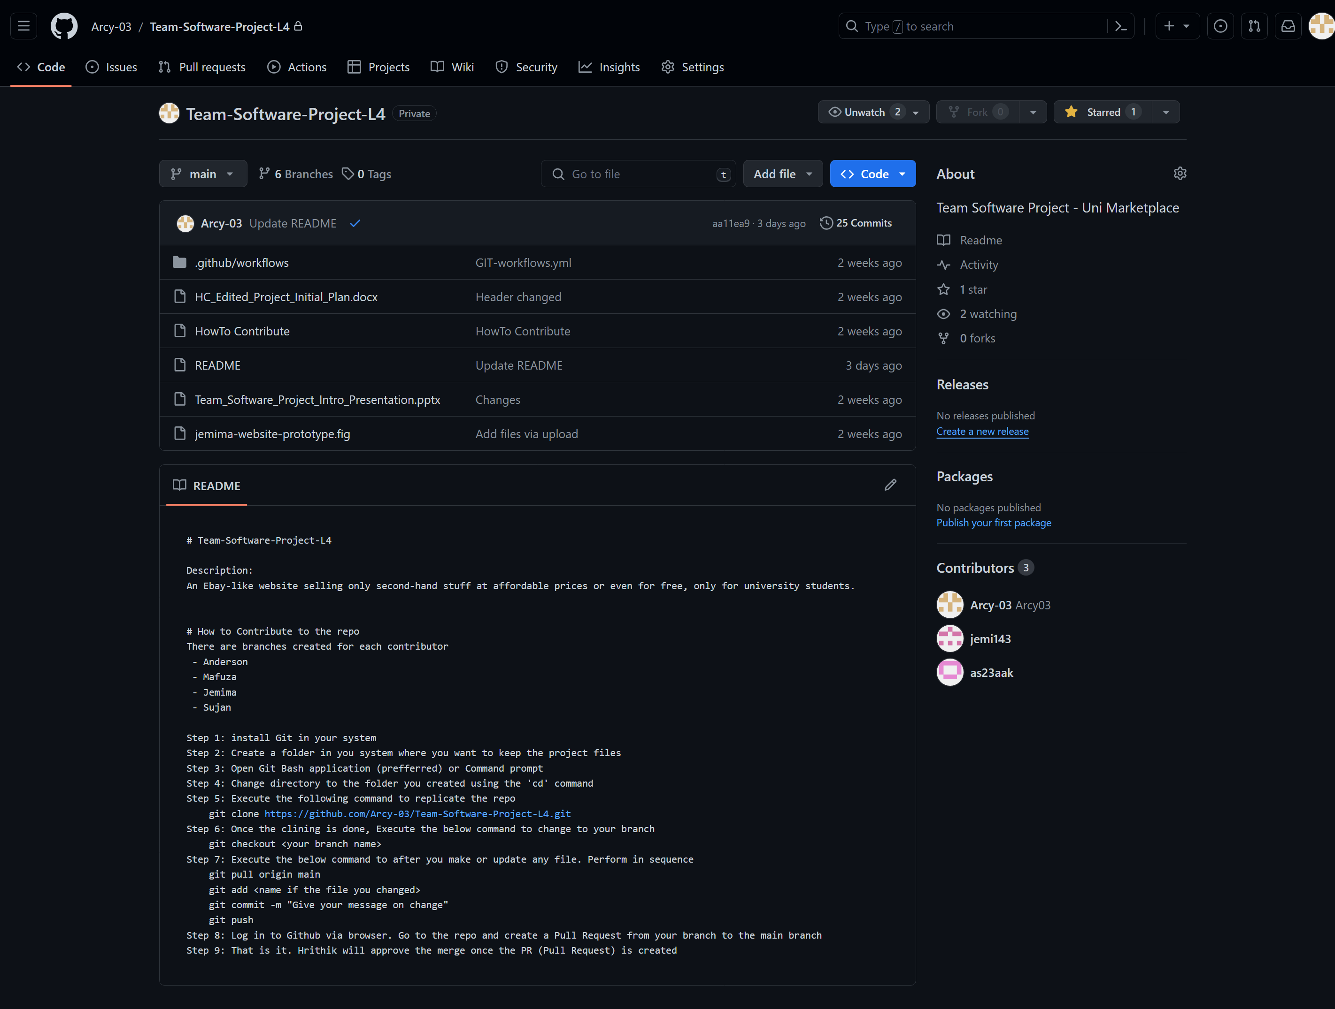
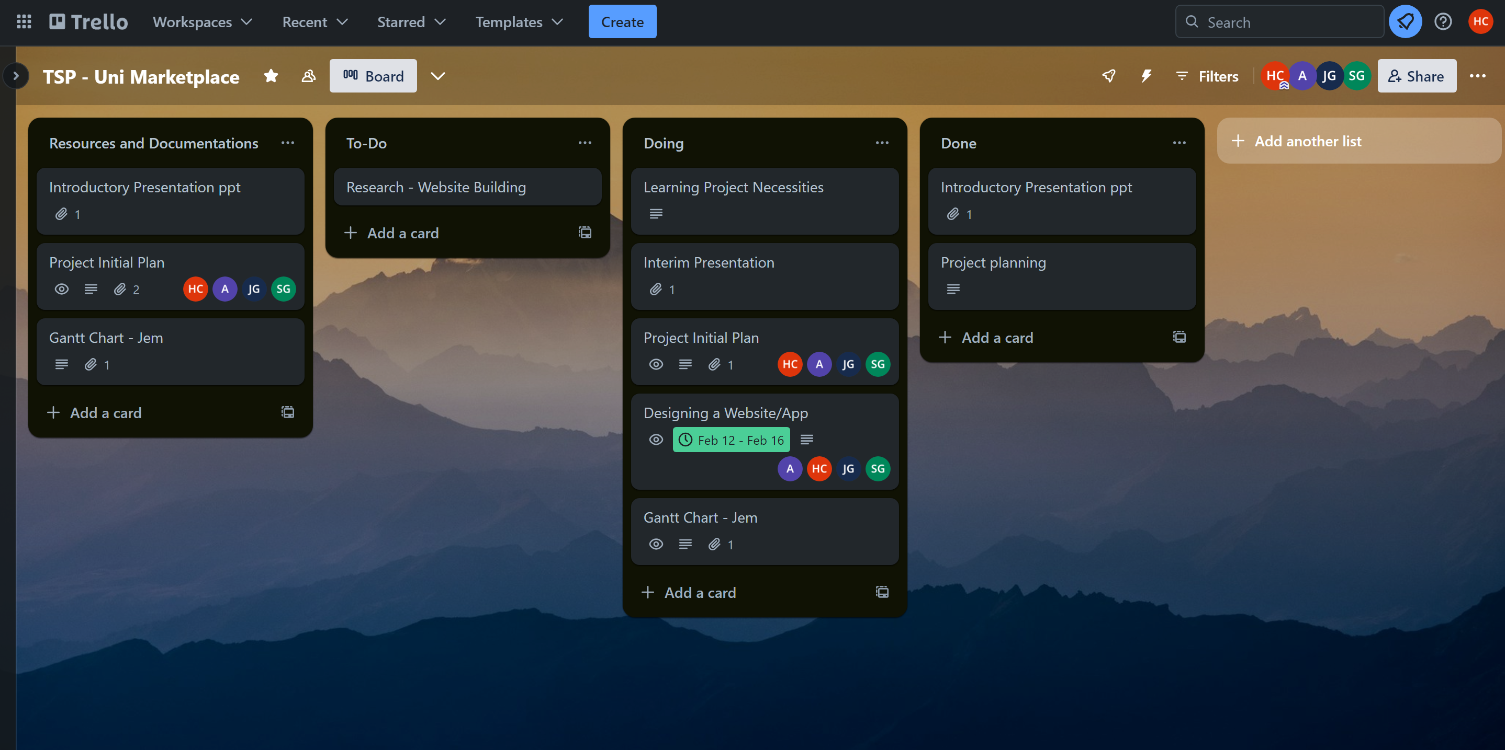
GitHub and Trello
Figma Design Link -Figma Design Link - https://www.figma.com/proto/fUYZfpZv77Da12zXoxAFG3/Website-design-prototype?page-id=183%3A2138&type=design&node-id=214-1006&viewport=801%2C4643%2C0.7&t=RHNCeBFMjXW5fAAP-1&scaling=scale-down&mode=design

Slide 11
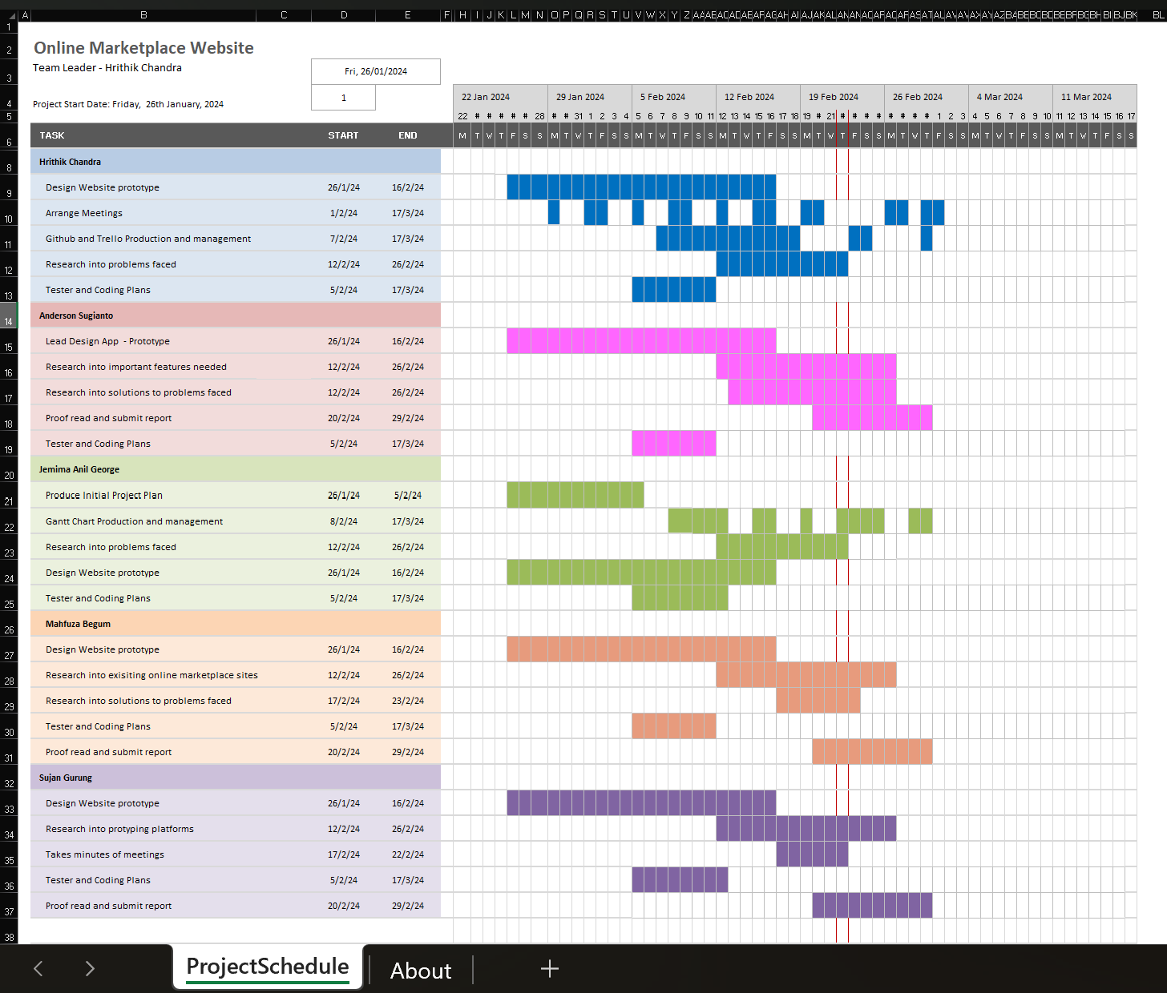
Jemima’s Work To Date
My main responsibilities in the group are to serve as Research Lead on Security systems needed for a web app, Prototyping and Tester.
I have conducted the following work to date:
Research into Security and Privacy systems to prevent misuse of similar online shopping platforms
Design a high-fidelity responsive website prototype using Figma
Gantt Chart Production and Management

Slide 12

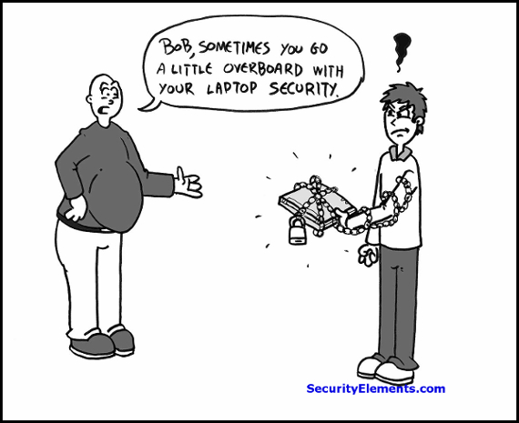
Research into Security and Privacy Systems
User Authentication
Encryption Protocols
Moderation
Store Policy
Consumer Feedback
User Reporting
Application Security
Regular backup
GDPR compliance
Notes:
In order to prevent misuse of the platform and protect customers from fraud, non-delivery scams, malicious usage of personal data
and sale of illegal products like drugs, weapons (or other items deemed inappropriate or unsafe.) , we need security and data protection measures
How to ensure their safety?
1.User Authentication such as password policies, (multi-factor authentication (MFA), implementing CAPTCHA or biometric authentication.) For Login, users must use student id and multi-factor authentication, this would ensure only university students have access.
2.Encryption Protocols: includes whether websites use HTTPS protocol, SSL(Secure Sockets Layer (SSL)/TLS certificates, which ensure that sensitive information such as login credentials and personal details are protected
3.Moderation can be done Either by a human or automated systems like Keyword Filtering to monitor prohibited items. (Keyword Filtering and AI algorithms: can automatically flag listings that contain inappropriate content. They can analyze product descriptions and even images.)
4.Store Policy: specifies what’s not allowed to be sold on the platform. User must be aware of the restrictions and consequences for violating them.
5.Understanding consumer needs through surveys or online reviews would give insight on areas where we can improve security measures.
6.Provide users with reporting mechanisms to flag suspicious or inappropriate listings. (Further reviewing and responding to the reports
7. Application Security Firewalls and Virus Scanners: are useful for external and internal security measure respectively, (protects the computer's network from unauthorized access. Virus Scanners: used as internal security measure. It scans files on server to detect any virus and block them.)
8. Regular backup: If your server is hacked, you have a backup to restore everything.
10. GDPR (General Data Protection Regulation) Law: - Was established to protect the privacy and security of personal data about individuals within the European Union and the European Economic Area.
(Although the UK has left the EU, it has incorporated the GDPR into its domestic law through the Data Protection Act 2018 .)
(7 Main Principles : - Lawfulness, fairness, and transparency; Purpose limitation; Data minimization; Accuracy; Storage limitation; Integrity and confidentiality; and Accountability)
Taking such proactive steps can create a safer and more enjoyable shopping experience, leading to higher levels of user satisfaction.
Some aspects of GDPR law includes:
Data Subjects' Rights: Individuals rights regarding their personal data, like the right to access, rectify, erase and restrict processing.
Consent: for data processing must be freely given, and individuals must be able to withdraw consent at any time.
Data Protection Principles: are lawfulness, fairness, transparency, purpose limitation, data minimization, accuracy, storage limitation, integrity and confidentiality, and accountability.
Data Breach Notification: Organizations must report certain types of personal data breaches to the relevant supervisory authority within 72 hours of the breach, unless it is unlikely to result in a risk to individuals' rights and freedoms.
International Data Transfers: imposes restrictions on the transfer of personal data outside the EU/EEA (to countries that do not provide an adequate level of data protection, requiring appropriate safeguards for such transfers.)
Penalties and Fines: Non-compliance with the GDPR can result in significant fines, with penalties

Slide 13
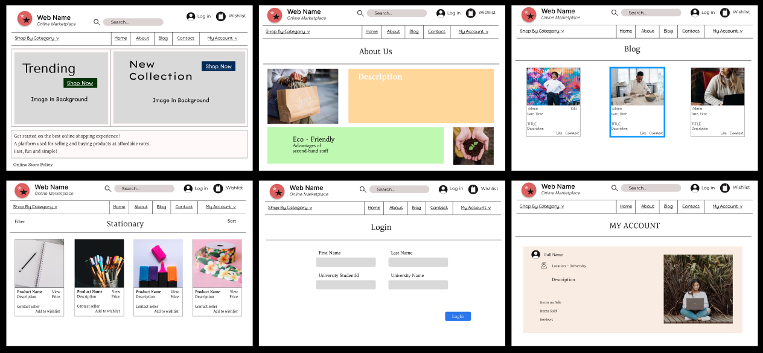
Jemima’s Work To Date
Figma Design Link: https://www.figma.com/proto/i4mnW1eAxPDSgukBVD7WpS/Online-Shopping-Website-Design?type=design&node-id=243-68&t=yR0KjlaXKRvFWHsI-1&scaling=min-zoom&page-id=243%3A67&starting-point-node-id=243%3A68&show-proto-sidebar=1&mode=design
Notes:
This is my website design – more of a text-based design. It has a home page, list of categories, about page, blog or review, product, login and account page.

Slide 14
Anderson’s Work To Date
My responsibilities in the group are to serve as a Design Lead for the mobile application.
I have conducted the following work to date:
Research into online shopping applications; I did research on eBay, Vinted and Depop and took design inspirations for certain features from them.
Designed a mobile application prototype for this project in Figma.

Slide 15
Research on eBay, Vinted, and Depop
Criteria | eBay | Vinted | Depop
Operation | Operates internationally, and offers international shipping | Operates on several countries, but doesn’t offer international shipping | Operates on several countries, and offers international shipping
Product Variety | Diverse product selections, but mostly sells electronics and collectibles | Offers multiple categories, but focused on fashion products (fit to use clothing) | Offers multiple categories, but focused on fashion products (current fashion trends)
Trending Age Group (avg.) | 25 to 34 years | 25 to 34 years | 18 to 24 years (Gen Z)
Seller | Individuals (second-hand products) Businesses (first-hand products) | Individuals (second-hand products) | Individuals (second-hand products)
Delivery Option | Products can be shipped, or in-person collection | Products must be shipped by the seller | Products must be shipped by the seller
Special Features | Auction | Buyers Protection | Have social features; likes, comments, and follows
Platform fees | Varies by category and listing format | Free | 10% For every products sold

Slide 16
What makes our marketplace different
Criteria | Our Marketplace
Operation | Operates in the UK (hypothetically in several universities)
Product Variety | Offers multiple categories, but focused on home products and university supplies
Trending Age Group (avg.) | 18 to 34 (Average age for undergraduate and postgraduate)
Seller | Individuals (second-hand products)
Delivery Options | Product must be collected in-person, around the campus
Platform Fees | Free

Slide 17
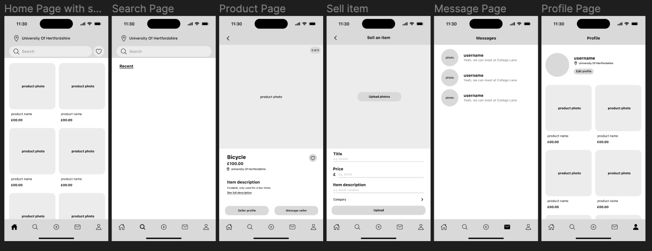
Anderson’s Design Work

Slide 18
Mahfuza’s Work To Date
My responsibilities in the group are to serve as the Visual Artist deciding the Logo, Colour Schemes and Fonts.
I have conducted the following work to date:
Research into Design – Standard design principles; human centric design ; Accessibility and Usability .
Designing Logos and Colour Schemes.

Slide 19
Design Implementation Principles
Contrast Color
Proportion of the size of elements
Re-Usable Elements
Use of Consistent shapes and elements
Using Empty spaces to create better UI
Notes:
There is constant disagreement on the number and nature of design principles, however there are twelve that frequently make an appearance on the list. Although these ideas are frequently discussed independently, they complement one another to produce designs that are both aesthetically pleasing and intuitive for the user.
Contrast Color,
Contrasting color highlights separates that specific passage of text from the surrounding material by bringing the reader's attention to it.
It helps in the readability of web content.
2. Proportion of the size of elements –
Helps to understand the hierarchy of important elements
3. Re-Usable Elements: can be utilized to establish Rhythm. Repetition generally creates Unity in a design without any extra effort on the part of the designer. But used intentionally, it can take that unity to a higher level. Helps in establishing consistency in designs and less effort in building modules (features, pages, etc.)
4. Use of Consistent shapes and elements –
If there are a variety of shapes in the design, it creates a chaotic experience to the viewer's eyes.
5. Using Empty spaces to create better UI
It is not always necessary for white space to be entirely white or pattern-free. The subtle Pattern can make white space more visually interesting while still enabling it to serve as a kind of visual "breathing space" within a design. Empty spaces can be filled with colors and patterns that are soothing to the eye, and in tandem to the page design.

Slide 20




Design Principles
Human Centric Design
Accessibility
Usability
Notes:
Human Centric Design --
What is human centred design?
By placing actual people at the centre of the development process, human-centred design is a problem-solving technique that helps you build products and services that speak to and meet the demands of your target audience. It revolves around four stages - Clarify, Ideate, Develop, Implement.
At every stage of the process, it is intended to keep the needs, desires, and preferences of the users front and centre. Since your clients (Students) have already tested the solution and are more invested in using it, you will be able to create more user-friendly, accessible items from their feedback making it likely to generate a bigger profit.
Accessibility –
The goal of accessible design is to ensure that no obstacles stand in the way of equal access for individuals with impairments when creating products.
Usability –
Usability of designs is about making products that are intuitive to use and has minimal learning curve to understand how to use them.

Slide 21


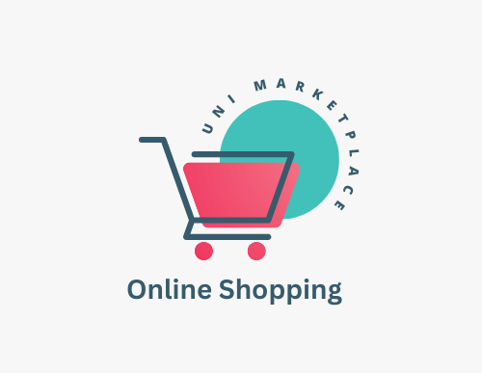
Colour Schemes & Logo
Notes:
A colour scheme with a high contrast between text and background should be chosen.
The text should be light, and vice versa, when there is a dark background.
The best contrast is provided by black and white, but it is better to not use that as it puts strain on our eyes.
Colour Schemes that are good for accessibility and usability.
The following combinations of colors should be avoided such as Green and red (or related colors) Blue and yellow or related color combinations.
Use a larger text and simple fonts, not ornate typefaces. It is preferable to use Sans serif fonts.
Not relying solely on color as a means of disseminating information. For example, it is not possible to rely on colour as the sole method of indicating heading level.
For emphasis, use bold colors instead of colours. On a photograph or gradient background, the text may be difficult to understand. If possible, set the text in a strong background.

Slide 22
Sujan’s Work To Date
My main responsibilities in the group are to design, build and code the website, and research into responsive web design.
I have conducted the following work to date:
Designed a mockup website in HTML & CSS with responsive web design approach.
Researched into responsive web design to build a mockup website.

Slide 23
Research on Responsive web design
RWD, or responsive web design, offers the best possible viewing experience. To build web pages, layouts are adjusted according to the size and orientation of the visitor's screen. The user experience is improved since contents are readily available across all devices without requiring a different design for each one.
Features of responsive web design
Fluid Grids – Pages are easily resized on various devices as grids are measured in relative units like percentages rather than in absolute units like pixels.
Flexible images – Prevents images from displaying within the screen width as images and files are sized in relative units.
Media Queries – Pages uses different CSS style rules according to the device's specifications.

Slide 24
Starting with Responsive Web Design
Understanding the basics
Mobile first approach.
Using fluid grids.
Enhanced images.
Using media queries.
Design testing.
Exploring and analyzing different responsive websites.

Slide 25
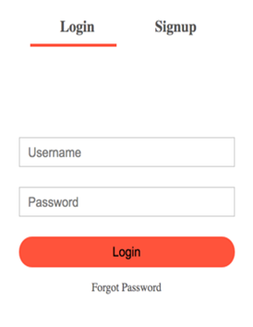
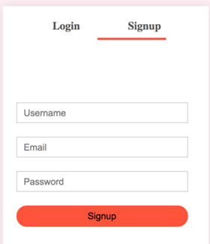
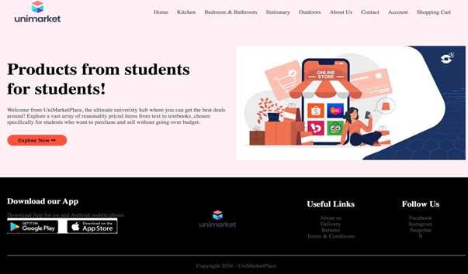
Features of the website
All the pages link to each other.
All pages have some similarities: the website logo, the navigation bar, which is bold and presents itself as the primary focus for the users; footers in all pages have same fonts.
Footer section is black so that all the letters are written in white stand out and are equally margined.
Products have equal margins between them; users can go to other pages with the pagination feature to see more products and there's also an option for ‘sort by’.
Account page is very user-friendly and lets the user register, or if they already have, they can log in.
Notes:
Research on design (design ideas) ---
1. What all sites were referred for benchmark --- eBay, Vinted, Depop,
2. Too much of cluttering, common designs like Home page, search bars, etc.
3. Research on eBay, Vinted, Facebook Marketplace --- How they look, comparison between their designs ( Short 3 – 5 points )

Slide 26
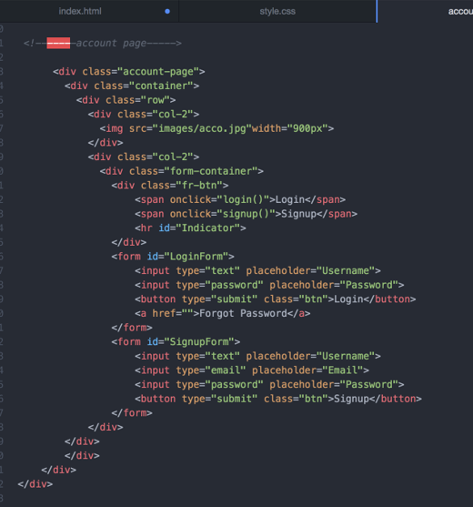
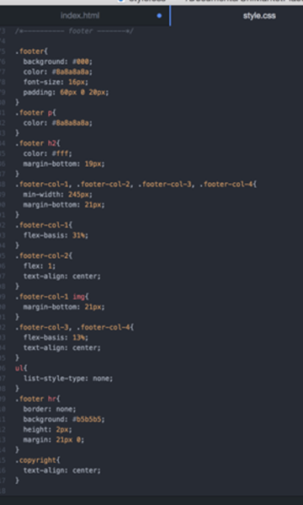
HTML code & CSS for Account Page

Slide 27
Project Management
The team has briefly considered project management approaches and have decided to adopt an agile approach.
Sprints will be created to ensure specific deliverables are achieved across three key stages:
1. Sprint 1 will contain a basic wireframe and mock-up – target date 16th February. 2. Sprint 2 will contain visual features and custom designs – target date 30th March. 3. Sprint 3 will contain final visual prototype – target date 12th April.
Notes:
Sprint Planning based on our original Design Plans and Customer Needs/Reviews.
We had quick meetings asking each member what they had done, what they are doing and what obstructs their progress, making our project management more effective.
Agile:
Always start from something simple
After many iterations/sprints, it becomes a refined and polished product.
Tasks are reviewed daily (or as frequently as they should be).
We used both Trello and GitHub
Trello -
Management based on 3 factors – To do, Doing and Done
GitHub -
Tracks code history (and allows reversion to previous state)
Collaborative/social coding - All members collaborate to the repository and make contribution to its development.

Slide 28
Tasks remaining
Create final design
Make a database for all products
Coding – Web app, User Authentication, User Reporting Mechanism, Drop-off/ Pick-up points
Testing

Slide 29
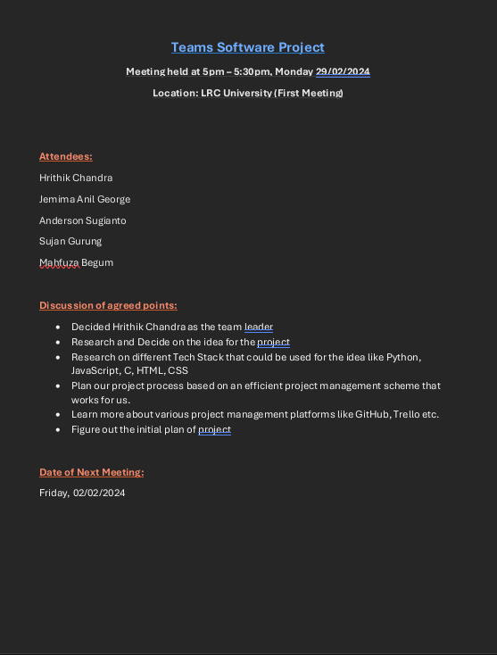
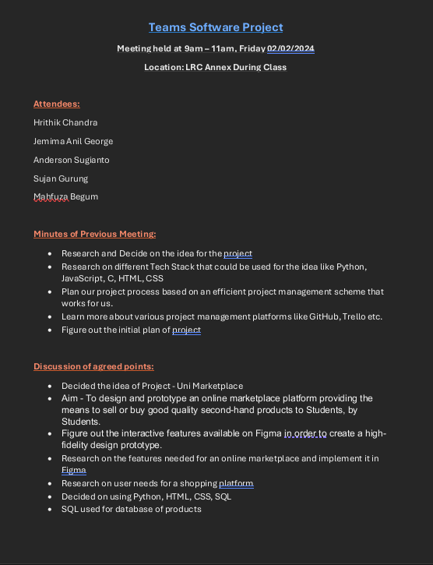
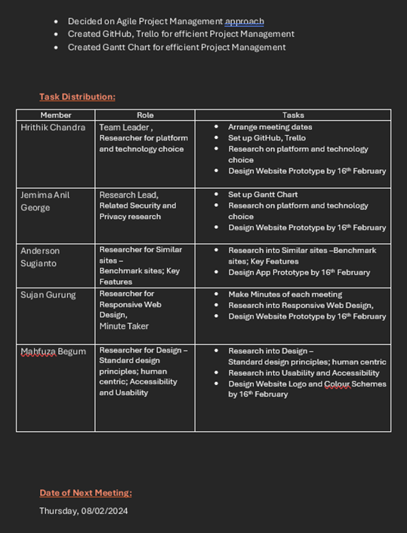
Minutes of Meeting - Agenda
Notes:
Meetings scheduled every week on Thursdays, Fridays (hybrid)

Slide 30
Additional Research slides
Back to Hrithik’s Work To Date
Main Research Points
Comparison between different platforms for development
Comparison between different technologies for building it
Comparison between different wireframing/design tools
References

Slide 31
Main Research Topics
Back
Research on similar sites (competition) – Reason why those sites are not suitable (product ideas) or are not a proper solution for our Problem Statement.
Too much of cluttering of pages, icons, links, etc.
Unrelated product listing which are not relevant for student life
Prohibitive costs for products – not suitable for students with limited revenue source
These can be some background of building a uni specific marketplace.
--------------------------------------------------------------------------------------------------------------------------------------------------------------------------------------------------
Research on design (design ideas)
What all sites were referred for benchmark; Responsive Web Design
Looking at standard design principles – human centric, accessibility and usability (W3C, WCAG etc sites)
Design thinking principles leading to material design approach of google
--------------------------------------------------------------------------------------------------------------------------------------------------------------------------------------------------
Related Security and Privacy research and associated laws
1. Securing data (user, product and transactions (not financial but any data exchanges happening)
2. Related laws that would apply (GDPR, Ethical standards related to the exchanges via this application (products or information)
--------------------------------------------------------------------------------------------------------------------------------------------------------------------------------------------------
Research on platform and technology choice
Whether to use tech and build ground up or leverage a hosting provider like Wix.
Notes:
MAIN RESEARCH TOPICS
Research on similar sites (competition) – Reason why those sites are not suitable (product ideas) or are not a proper solution for our Problem Statement
Too much of cluttering
Unrelated product listing which are not relevant for student life
Prohibitive costs for products – not suitable for students with limited revenue source
These can be some background of building a uni specific marketplace.
---------------------------------------------------------------------------------------------------------------------------------------------------------------------------------------------------------
Research on design (design ideas)
What all sites were referred for benchmark
Looking at standard design principles – human centric, accessibility and usability (W3C, WCAG etc sites)
Design thinking principles leading to material design approach of google
---------------------------------------------------------------------------------------------------------------------------------------------------------------------------------------------------------
Related Security and Privacy research and associated laws
1. Securing data (user, product and transactions (not financial but any data exchanges happening))
2. Related laws that would apply (GDPR, Ethical standards related to the exchanges via this application (products or information)
---------------------------------------------------------------------------------------------------------------------------------------------------------------------------------------------------------
Research on platform and technology choice
Whether to use coding and build ground up or leverage a hosting provider like Wix

Slide 32
Comparison between different platforms for development
Back
Factor | Website | Native App | Hybrid App | Web App
Development Language | HTML, CSS, JavaScript | Platform-specific (e.g., Swift, Java/Kotlin) | HTML, CSS, JavaScript wrapped in a native container | HTML, CSS, JavaScript
Distribution | Accessed through web browsers | Distributed through app stores | Distributed through app stores | Accessed through web browsers
Platform Dependency | Platform-independent | Platform-specific (iOS, Android) | Platform-independent | Platform-independent
Access to Device Features | Limited | Full access to device features | Limited access to device features | Limited access to device features
Performance | Typically lower performance | High performance | Performance may not match native apps | Performance may not match native apps
Updates & Maintenance | Centralized updates & maintenance | Updates may require users to download | Centralized updates & maintenance | Centralized updates & maintenance
Time to Market | Quick deployment | Longer development time | Shorter development time than native apps | Quick deployment
Development Cost | Lower cost | Higher cost | Moderate cost | Lower cost
Accessibility | Easily accessible through browsers | Requires installation | Requires installation | Easily accessible through browsers
Ideal Use Case | Informational websites, marketing sites | Applications requiring high performance and device integration | Applications requiring cross-platform compatibility | Starting websites, rapid deployment

Slide 33
Comparison of various solutions of making a Web App
Back
Method | Description
Custom Coding | Writing code from scratch using programming languages such as HTML, CSS, JavaScript, and backend technologies like Node.js, Python, or Ruby on Rails.
Frontend Frameworks | Utilizing frontend frameworks like React, Angular, Vue.js, or Svelte to accelerate development and provide structure for building interactive web applications.
Backend as a Service (BaaS) | Using backend-as-a-service platforms like Firebase, AWS Amplify, or Parse to handle server-side logic, database management, and user authentication without managing server infrastructure.
Content Management Systems (CMS) | Building web apps using CMS platforms like WordPress, Joomla, or Drupal, which offer pre-built themes, plugins, and content management features for easy website creation and management.
Low-Code Platforms | Leveraging low-code development platforms like OutSystems, Mendix, or Microsoft Power Apps to visually design and configure web applications with minimal coding, using drag-and-drop interfaces and pre-built components.
No-Code Platforms | Creating web apps without writing any code using no-code platforms such as Bubble, Webflow, or Wix, which provide intuitive visual editors for designing and deploying web applications using pre-built templates and components.
Website Builders | Building simple web applications using website builders like Squarespace, Weebly, or Shopify, which offer user-friendly interfaces for designing websites and online stores without coding.
Integration Platforms | Integrating existing services and APIs to create custom web applications using integration platforms like Zapier, Integromat, or IFTTT, which allow users to automate workflows and connect different apps without writing code.

Slide 34
Comparison of various Wireframing/Designing Tools
Tool | Description | Platform | Key Features
Figma | Cloud-based design tool with collaborative features, offering powerful prototyping and design capabilities. | Web, macOS, Windows, Linux | Real-time collaboration, responsive design, prototyping, components, plugins, version history.
Adobe XD | Vector-based design tool for creating wireframes, prototypes, and UI designs, with integration with other Adobe products. | macOS, Windows | Repeat Grid, Auto-Animate, Prototyping, Voice Prototyping, Design Specs, Plugins, Adobe Creative Cloud integration.
InVision Freehand | Online whiteboard tool for collaborative sketching, wireframing, and brainstorming sessions, integrated with InVision's other products. | Web | Real-time collaboration, Freehand drawing, Sticky notes, Comments, Integration with InVision Studio and DSM.
Balsamiq Wireframes | Rapid wireframing tool for creating low-fidelity mockups and prototypes with a hand-drawn look and feel. | Web, macOS, Windows | Drag-and-drop interface, Sketch-style wireframes, UI components, Linking, Exporting to PDF/PNG.
Canva | Web-based graphic design platform offering a wide range of templates and tools for creating wireframes, designs, and presentations. | Web | Drag-and-drop interface, Templates, Stock photos, Fonts, Icons, Collaboration, Exporting to various formats.
Pen & Paper | Traditional method of sketching wireframes and designs using pen and paper or a digital tablet. | N/A | Low-cost, Quick and flexible, No learning curve, No software required, Portable.

Slide 35
References
Back To
Additional Research Slides
Production Sources -
Figma - Figma: The Collaborative Interface Design Tool
GitHub - GitHub
Arcy-03/Team-Software-Project-L4 (github.com) [Team GitHub Repo]
Trello - TSP - Uni Marketplace | Trello
Iconify - https://iconify.design
Microsoft PowerPoint
Design Inspiration Sources -
Amazon (Mobile and Website) - Amazon.co.uk: Low Prices in Electronics, Books, Sports Equipment & more
eBay (Mobile and Website) - Electronics, Cars, Fashion, Collectibles & More | eBay
Patagonia - Patagonia Outdoor Clothing & Gear
Depop - Depop - buy, sell, discover unique fashion
Vinted - Vinted | Sell and buy clothes, shoes and accessories
Facebook Marketplace – https://www.facebook.com/marketplace
Accessibility and Usability –
Chapman, C. (2019, September 24). Breaking down the principles of design (with infographic): Topal®. Topal Design Blog. https://www.toptal.com/designers/gui/principles-of-design-infographic#:~:text=There%20are%20twelve%20basic%20principles,movement%2C%20variety%2C%20and%20unity.
https://online.hbs.edu/blog/post/what-is-human-centered-design
Relationship Between Web Accessibility and Usability: https://www.w3.org/WAI/EO/Drafts/access-use/accessibility-n-usability2010-09Sep-09.html#:~:text=Usability%20is%20about%20making%20products,no%20barriers%20preventing%20equal%20access.
Colour contrast. Accessibility by Design: https://www.chhs.colostate.edu/accessibility/best-practices-how-tos/color-contrast/#:~:text=Choose%20a%20color%20scheme%20that,and%20white%20provide%20maximum%20contrast.)
Technology and Design Research –
What Is Responsive Web Design? And How to Get Started | Coursera
UI vs. UX Design: What’s the Difference? | Coursera
High-Fidelity Prototyping: What Is It And How Can It Help? | Figma
ChatGPT (openai.com) and Bing CoPilot

Slide 36
References
https://www.g2.com/products/unimarket/reviews
https://freepngimg.com/png/75298-play-google-tea-button-knorr-now-lipton
Apple Store vs. Google Play. What is better? | iGotOffer
W3Schools (2023). HTML Responsive Web Design. [online] W3schools.com. Available at: https://www.w3schools.com/html/html_responsive.asp.
Coursera. (n.d.). What Is Responsive Web Design? And How to Get Started. [online] Available at: https://www.coursera.org/articles/responsive-web-design.
www.w3schools.com. (n.d.). CSS Colors. [online] Available at: https://www.w3schools.com/cssref/css_colors.php.
HTML Arrows. (2017). HTML Symbols, Entities and Codes — Toptal Designers. [online] Available at: https://www.toptal.com/designers/htmlarrows/symbols/.
W3Schools (2018). HTML Tutorial. [online] W3schools.com. Available at: https://www.w3schools.com/html/.
MDN Web Docs. (2019). CSS reference. [online] Available at: https://developer.mozilla.org/en-US/docs/Web/CSS/Reference.
‌
‌
‌
‌
‌
‌
at:
‌

Slide 37
Thank You!!
And have a nice day !

